Slide 1

LEARNQUEST: GAMIFIED & OFFLINE-FIRST LEARNING PLATFORM FOR RURAL STUDENTS
PYTHON PROGRAMMING – CSA0804/SLOT D
Domain: EdTech / Digital Learning
Technology: Python, Flask/Django, HTML, CSS
Tagline: Learn. Play. Progress. Anywhere.
BY:
PRANATHI L(192365049)
MANASVI(192425084)
SIVARANGJENII B (192521375)
VAIBHAVA LAKSHMI K (192511310)
UNDER THE GUIDANCE:
DR.JEGATHEESAN

Slide 2


OBJECTIVE
THE CHALLENGE IN DIGITAL LEARNING
Rural students often face unstable or limited internet connectivity.
Traditional learning platforms can become boring and less engaging.
Teachers have limited tools to track individual learning progress.
Existing systems often focus on marks rather than improvement and consistency.

Slide 3
SOLUTION
INTRODUCING LEARNQUEST
Provides subject-wise modules containing text, videos and interactive quizzes.
Uses XP, levels, badges and challenges to motivate continuous learning.
Provides low-bandwidth and offline-friendly access to learning content.
Gives teachers dashboards and performance insights for better intervention.

Slide 4

WORKING
STUDENT LEARNING JOURNEY
Learn: Students access subject-wise lessons and educational content.
Practice: Interactive quizzes help students test their understanding.
Earn: Students gain XP, badges and levels through learning activities.
Improve: Progress analytics identify weak areas and encourage revision.
VISUAL FLOW: Learn → Practice → Earn → Improve → Repeat

Slide 5
GAMIFICATION
TURNING LEARNING INTO A GAME
Students earn Experience Points (XP) for completing meaningful learning activities.
Levels and badges provide visible milestones and achievements.
Streaks and challenges encourage students to maintain regular learning habits.
Multiple leaderboard categories reward performance, improvement and consistency.

Slide 6
UNIQUE INNOVATION
GROWTH-BASED LEADERBOARD
Traditional leaderboards mainly reward students with the highest marks.
LearnQuest also recognizes students who show significant improvement.
Separate recognition can be given for Top Performer, Most Improved and Most Consistent.
This creates a more inclusive competition where every student has a reason to participate.

Slide 7
OFFLINE & LOW-BANDWIDTH LEARNING
LEARNING EVEN WHEN THE INTERNET DOESN'T
Lightweight pages and text-first content reduce data consumption.
Important lessons and quizzes can be cached for offline access.
Student activities can be stored locally when the connection is unavailable.
Progress is synchronized with the server when connectivity returns.
VISUAL FLOW: Online → Download → Offline Learning → Local Progress → Reconnect → Sync

Slide 8
TEACHER DASHBAORD
FROM MARKS TO MEANINGFUL INSIGHTS
Teachers can monitor student and class-level performance.
Subject and module analytics help identify difficult learning topics.
Teachers can track quiz scores, completion rates and engagement.
Performance reports support targeted revision and academic intervention.

Slide 9
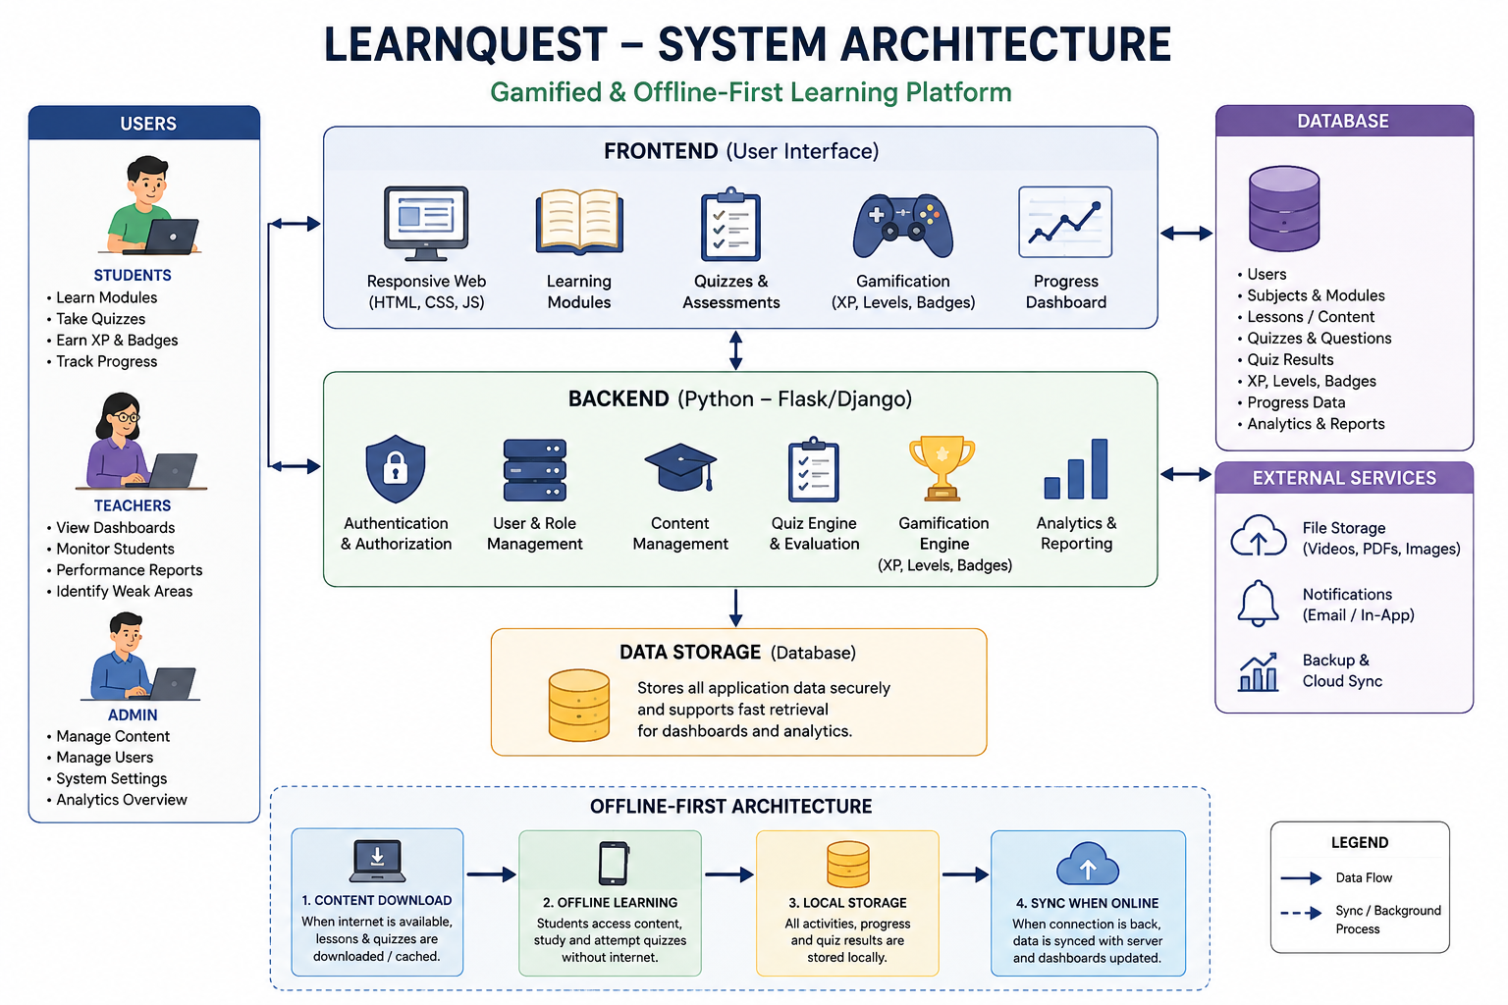
SYSTEM ARCHITECTURE

Slide 10
KEY FEATURES
ONE PLATFORM, COMPLETE LEARNING EXPERIENCE
Subject-wise Learning: Modules, text and videos organized by subject.
Interactive Assessment: Quizzes with instant results and feedback.
Gamified Progress: XP, levels, badges, streaks and leaderboards.
Smart Monitoring: Student progress and teacher performance dashboards.

Slide 11
EXPECTED IMPACT
CREATING MORE INCLUSIVE DIGITAL EDUCATION
Students: Higher engagement, motivation and consistent learning.
Teachers: Faster identification of weak areas and better progress monitoring.
Rural Communities: Reduced dependence on continuous high-speed internet.
Education System: Data-supported learning with greater accessibility and participation.

Slide 12
FUTURE SCOPE
Personalized Recommendations: Suggest lessons based on individual performance.
Regional Languages: Support local-language learning for wider accessibility.
Adaptive Quizzes: Automatically adjust question difficulty based on student progress.
AI & Voice Learning: Future integration of AI tutoring and voice-based educational support.

Slide 13
CONCLUSION
OUR VISION
LearnQuest combines education, gamification, analytics and accessibility.
It transforms learning from a passive activity into an interactive learning journey.
Its offline-first approach makes digital education more suitable for low-connectivity environments.
Our vision is to make quality, engaging and measurable learning accessible to every student.

